Slide 1







Empowering Digital Pedagogy
Foundations of PK, TK & Professional Engagement
Project n° 2024-1-AT01-KA220-ADU-000254167

Slide 2
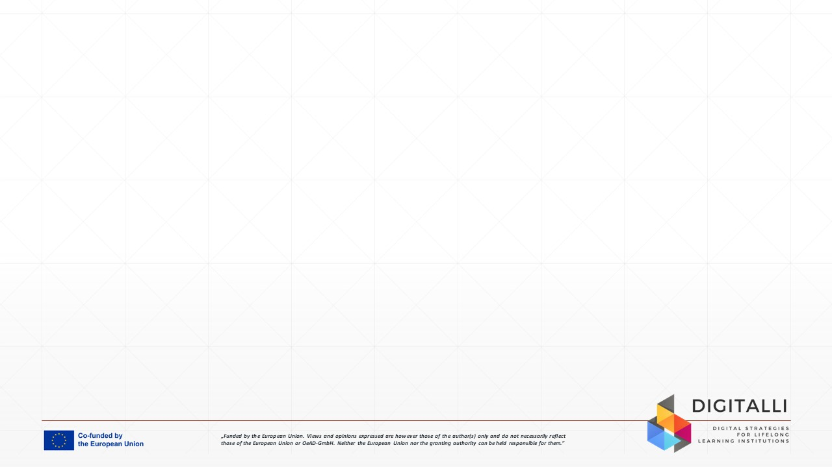

Unit Aim
• Strengthen foundations of digital pedagogy
• Develop pedagogical (PK) and technological knowledge (TK)
• Support reflective practice and collaboration
• Focus on adult education contexts
Image by Pixabay

Slide 3

Learning Outcomes
After completing this SDL unit, you will have gained the following knowledge, skills and attitudes:
LO 1: Understand the role of PK and TK in digital teaching
LO 2: Reflect on your own digital teaching practice
LO 3: Identify opportunities for professional engagement
Image by Freepik

Slide 4
Unit Overview
Adult learning in digital contexts
Adult learners bring experience and clear goals into learning. Digital learning should be relevant, practical, and support autonomy.
Pedagogical Knowledge (PK)
Pedagogical Knowledge focuses on how learning is designed and facilitated. In digital contexts, pedagogy guides the use of technology.
Technological Knowledge (TK)
Technological Knowledge refers to understanding and using digital tools purposefully. The focus is on supporting learning, not on tools themselves.
Professional engagement & reflection
Professional engagement includes collaboration, communication, and continuous development. Reflection supports improvement of digital teaching practice.

Slide 5

Case Study: Context and Challenge
Starting Digital Transformation in an Adult Education Centre
A small adult education centre works with diverse adult learners, including people from rural areas and learners with fewer opportunities. Educators have different professional backgrounds and varying levels of experience with digital teaching.Digital tools are mainly used for administration and basic communication, while their potential to support learning, reflection, and collaboration is not yet fully developed.
Image by Freepik

Slide 6
Case Study: Pedagogical Perspective
Educators recognise the need to improve digital teaching practices but are unsure how to start. Some focus mainly on tools, while others avoid technology due to uncertainty about pedagogy and lack of confidence. Professional collaboration and shared reflection are limited, even though educators express interest in learning from each other and developing their digital competences together.
Image by Freepik

Slide 7

Case Study: Reflection Questions
What challenges related to digital pedagogy can you identify in this case?
How do pedagogical knowledge (PK) and technological knowledge (TK) currently appear in the educators’ practice?
In what ways could professional collaboration and reflection support digital teaching development in this context?
Image by Freepik

Slide 8

Activity 1:
My Digital Pedagogy Map
This activity invites you to reflect on your current digital teaching and professional practices. You will explore how digital tools you use connect to pedagogical goals and professional engagement. The focus is on understanding why and how technology is used, not on evaluating specific tools.
Image by Freepik

Slide 9
Activity: My Digital Pedagogy Map
Use the My Digital Pedagogy Map activity sheet.
List the digital tools or platforms you currently use in teaching or professional work (TK)
Identify the pedagogical purpose each tool supports (e.g. engagement, explanation, reflection) (PK)
Reflect on how these tools support collaboration, reflection, or professional development
You may use selected elements of the DIGITALLI Toolkit as a reference to support your reflection.
Estimated time: 40–45 minutes
Image by Freepik

Slide 10

Activity 2: From Tools to Pedagogy
This activity focuses on transferring reflection into practice. You will identify one area of your digital teaching or professional collaboration where pedagogy should guide technology use more clearly. The aim is to move from thinking about tools to making intentional pedagogical decisions that support learning and professional engagement.
Image by Freepik

Slide 11
Activity: From Tools to Pedagogy
Reflect on your practice and plan one small, realistic improvement.
Choose one digital practice you currently use (or avoid)
Define the pedagogical goal you want to support (e.g. engagement, understanding, reflection)
Identify how technology could better support this goal
Describe one concrete change you will test in your teaching or professional collaboration
Use Activity Sheet 2: From Tools to Pedagogy – Reflection to guide your work.
Estimated time: 30–35 minutes
Image by Freepik

Slide 12
Tips for Educators
Tip 1
Start with clear learning goals and adult learners’ needs before choosing any digital tool. This helps ensure that technology supports learning rather than driving it.
Tip 3
Share experiences, challenges, and small successes with colleagues to build a culture of professional learning and mutual support.
Tip 2
Use digital technologies to support reflection, interaction, and collaboration, not only content delivery or administration.
Tip 4
Focus on small, realistic changes in practice that can be tested and improved over time, rather than complex or overwhelming solutions.

Slide 13
Additional Resources
DIGITALLI Toolkit (WP2)
DigCompEdu Framework
DIGITALLI Learning Resources
Human Capital perspective and self-reflection tools available on the project website.
Professional Engagement area supporting reflection, collaboration, and professional development.
Project learning materials and self-reflection resources supporting digital pedagogy development.

Slide 14

Assessment
Q1: Which statement best describes Pedagogical Knowledge (PK) in digital education?
A) Knowledge of digital tools and platforms.
B) Knowledge of teaching strategies and how adults learn.
C) Knowledge of assessment software.
D) Knowledge of online content formats.
Reason: Pedagogical Knowledge focuses on how learning is designed and facilitated, regardless of the technology used.
Image by Freepik

Slide 15


Assessment
Q2: What does Technological Knowledge (TK) mainly refer to in digital pedagogy?
A) Advanced technical skills for using complex software.
B) Understanding and using digital tools purposefully to support learning.
C) Knowledge of learners’ digital skills.
D) Ability to automate teaching and assessment.
Reason: Technological Knowledge focuses on understanding how digital tools can be selected and used meaningfully to support pedagogical goals, not on technical expertise.

Slide 16
Assessment
Q3: Which practice best represents professional digital engagement according to DigCompEdu?
A) Using digital tools only for delivering learning content.
B) Completing administrative tasks digitally.
C) Collaborating with colleagues, reflecting on practice, and engaging in digital professional development.
D) Replacing face-to-face teaching with online materials.
Reason: Professional digital engagement includes collaboration, communication, reflective practice, and continuous professional development supported by digital technologies.

Slide 17
Assessment
Q4: Why is reflective practice important in digital pedagogy for adult educators?
A) It helps reduce the use of digital technologies.
B) It replaces the need for professional training.
C) It supports continuous improvement of teaching practice and informed use of technology.
D) It focuses only on collecting learner feedback.
Reason: Reflective practice enables educators to critically evaluate their teaching decisions, learn from experience, and continuously improve how digital technologies support learning.

Slide 18
Assessment
Q5: Which approach best supports effective digital pedagogy in adult education?
A) Choosing digital tools first and adapting teaching afterwards.
B) Using as many digital tools as possible to increase engagement.
C) Letting technology determine teaching methods.
D) Starting from pedagogical goals and selecting technology to support them.
Reason: Effective digital pedagogy begins with clear pedagogical intentions. Technology should be selected and used only to support learning goals, not to drive teaching decisions.

Slide 19

Self-Reflection Questions
Take a moment to reflect on your learning from this unit.
Which aspect of your digital pedagogy do you feel most confident about after completing this unit?
In which area would you like to further develop your pedagogical or technological practice?
What is one concrete action you plan to take in your teaching or professional collaboration in the near future?

Slide 20
References
Redecker, C. (2017). European framework for the digital competence of educators: DigCompEdu. Publications Office of the European Union. https://doi.org/10.2760/159770
Mishra, P., & Koehler, M. J. (2006). Technological pedagogical content knowledge: A framework for teacher knowledge. Teachers College Record, 108(6), 1017–1054.
DIGITALLI Consortium. (2024). DIGITALLI toolkit (WP2): Human capital perspective and self-reflection tools. Erasmus+ KA220-ADU Project.

Slide 21
Conclusion
This unit focused on the foundations of digital pedagogy in adult education, highlighting the importance of pedagogical knowledge, technological knowledge, and professional digital engagement.
You explored how pedagogy should guide the use of digital technologies, how reflection supports continuous improvement, and how collaboration contributes to professional development.

Slide 22

Congratulations on completing the Unit 1: Empowering Digital Pedagogy!

Slide 23






Project partners:
Project n° 2024-1-AT01-KA220-ADU-000254167
„Funded by the European Union. Views and opinions expressed are however those of the author(s) only and do not necessarily reflect those of the European Union or OeAD-GmbH. Neither the European Union nor the granting authority can be held responsible for them.“

