Slide 1
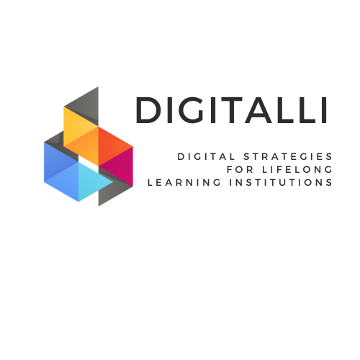






Designing Digital Learning Experiences
Using CK and TCK for Learner-Centred Digital Content
Project n° 2024-1-AT01-KA220-ADU-000254167

Slide 2
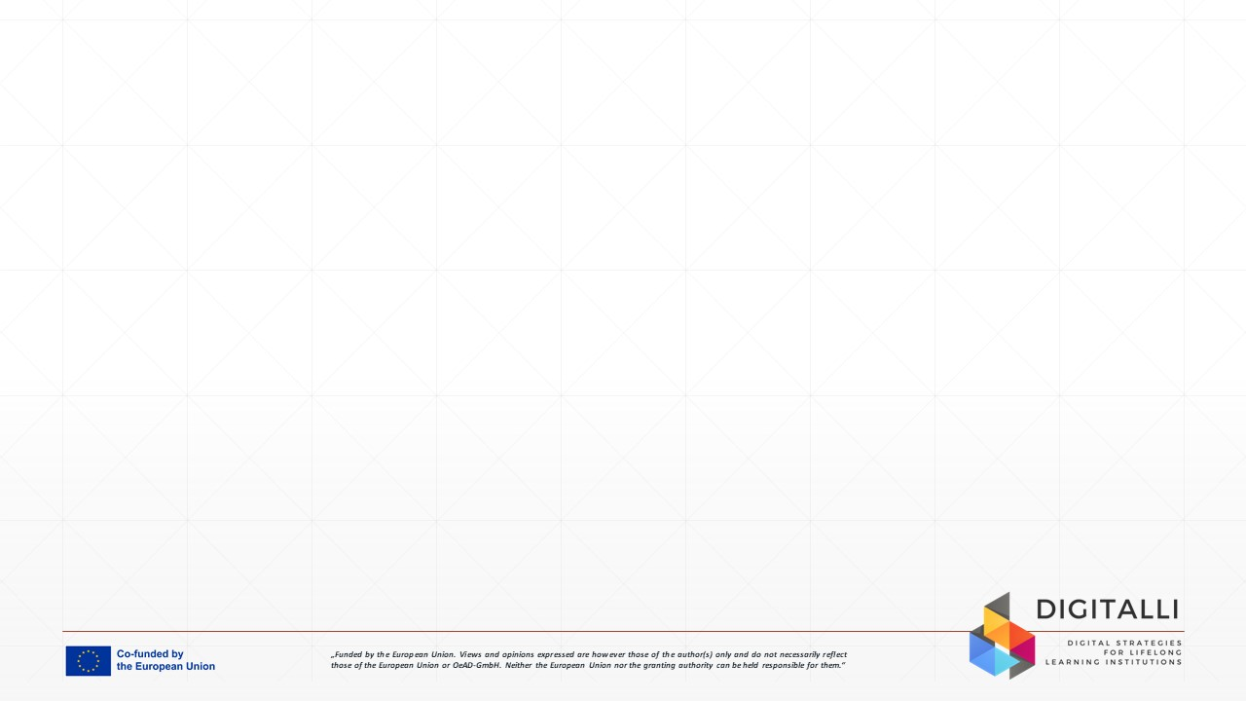

Unit Aim
The aim of this unit is to support adult educators and trainers in designing effective digital learning experiences that are grounded in clear content goals and learner needs. You will develop the skills and confidence to select, adapt, and use digital and AI-supported resources to enhance subject teaching.
This unit focuses on creating learner-centred, accessible, and practical digital materials that build on adult learners’ experience and support self-directed learning. By the end of the unit, you will be better equipped to design meaningful digital learning activities where technology supports understanding, engagement, and real-world application.
Image by Freepik

Slide 3

Learning Outcomes
After completing this SDL unit, you will have gained the following knowledge, skills and attitudes:
LO 1: Understand learner-centred digital design, evaluate resources for quality, accessibility, relevance, and alignment with adult learning contexts.
LO 2: Apply factual knowledge of digital and AI-supported tools to adapt and create inclusive, content-aligned learning materials supporting subject-specific instruction.
LO 3: Show openness to experimentation and willingness to adapt digital content, valuing adult learners’ prior experiences while using technology to support planning responsibly.
Image by rawpixel on Freepik

Slide 4
Unit Overview
Content Knowledge in Digital Learning
This topic focuses on starting digital lesson design from clear subject goals. You will learn how to choose digital resources that support your content, connect to adult learners’ real-life experiences, and remain practical and relevant.
Using Technology to Support Content
You learn and explore how digital tools can strengthen subject teaching. You will see how tools such as collaborative documents, videos, or simulations can help learners understand content more deeply.
Selecting and Adapting Digital Resources
This topic helps you evaluate digital resources for quality, accessibility, and inclusiveness. You will practice adapting existing materials and open educational resources instead of creating everything from scratch.
Using AI to Support Learning Design
You will explore how AI tools can support lesson planning and content adaptation. The focus is on using AI to generate ideas, examples, or simplified explanations while keeping full pedagogical control.

Slide 5

Content Knowledge in Digital Learning
Content Knowledge (CK) refers to an educator’s understanding of the subject matter and its structure, key concepts, and real-world applications. In digital learning design, CK provides the foundation for deciding what learners should understand before considering how technology is used.
Effective digital lesson design begins with clearly defined learning goals that are relevant to adult learners’ professional, personal, or civic contexts. Digital tools should be selected to clarify concepts, illustrate processes, or support application of knowledge, rather than simply adding technology for its own sake.
Examples include using short explainer videos to introduce complex topics, interactive diagrams to visualise processes, or case-based scenarios that reflect real workplace or life situations familiar to adult learners. Open Educational Resources (OER) can also be adapted to align content with local or sector-specific needs.
Adult learners benefit most when digital learning connects new information to their prior knowledge and experience, supports practical problem-solving, and allows immediate application. Educators are encouraged to start by identifying one core learning objective and selecting a digital resource that directly supports understanding and meaningful engagement with the content.
Image by Freepik

Slide 6

Using Technology to Support Content
Technological Content Knowledge (TCK) describes how digital tools can be selected and used to represent subject content in ways that deepen understanding and support learning. It focuses on the relationship between what is taught and which technologies best support that content.
Digital tools can enhance subject teaching by visualising complex ideas, enabling exploration, and supporting active engagement. Examples include collaborative documents such as Google Docs for analysing texts together, short instructional videos to demonstrate procedures, and simulations that allow learners to experiment with real-world scenarios in a safe environment.
When used purposefully, technology helps learners move beyond passive consumption toward active meaning-making. Adult learners benefit especially when tools support exploration, discussion, and application of content relevant to their work or daily lives.
Educators are encouraged to select technologies based on their contribution to content understanding, starting with one tool aligned to a clear learning objective and refining its use based on learner feedback and outcomes.
Image by Freepik

Slide 7

Selecting and Adapting Digital Resources
Selecting appropriate digital resources is a key part of effective digital learning design. Educators need to evaluate resources not only for content accuracy, but also for pedagogical quality, accessibility, and inclusiveness for diverse adult learners.
Important criteria include clarity of language, alignment with learning objectives, compliance with accessibility principles (such as readable formats and captions), and adaptability to different learning contexts. Open Educational Resources (OER) are particularly valuable, as they can be legally adapted to meet local, cultural, or sector-specific needs.
Rather than creating all materials from scratch, educators are encouraged to adapt existing resources by simplifying language, adding practical examples, or restructuring content into shorter learning units. This approach saves time, ensures consistency, and supports learner-centred design.
Adult learners benefit when adapted resources respect their prior knowledge, allow flexible pacing, and provide clear pathways for applying learning in real-life or workplace situations.
Image by Freepik

Slide 8
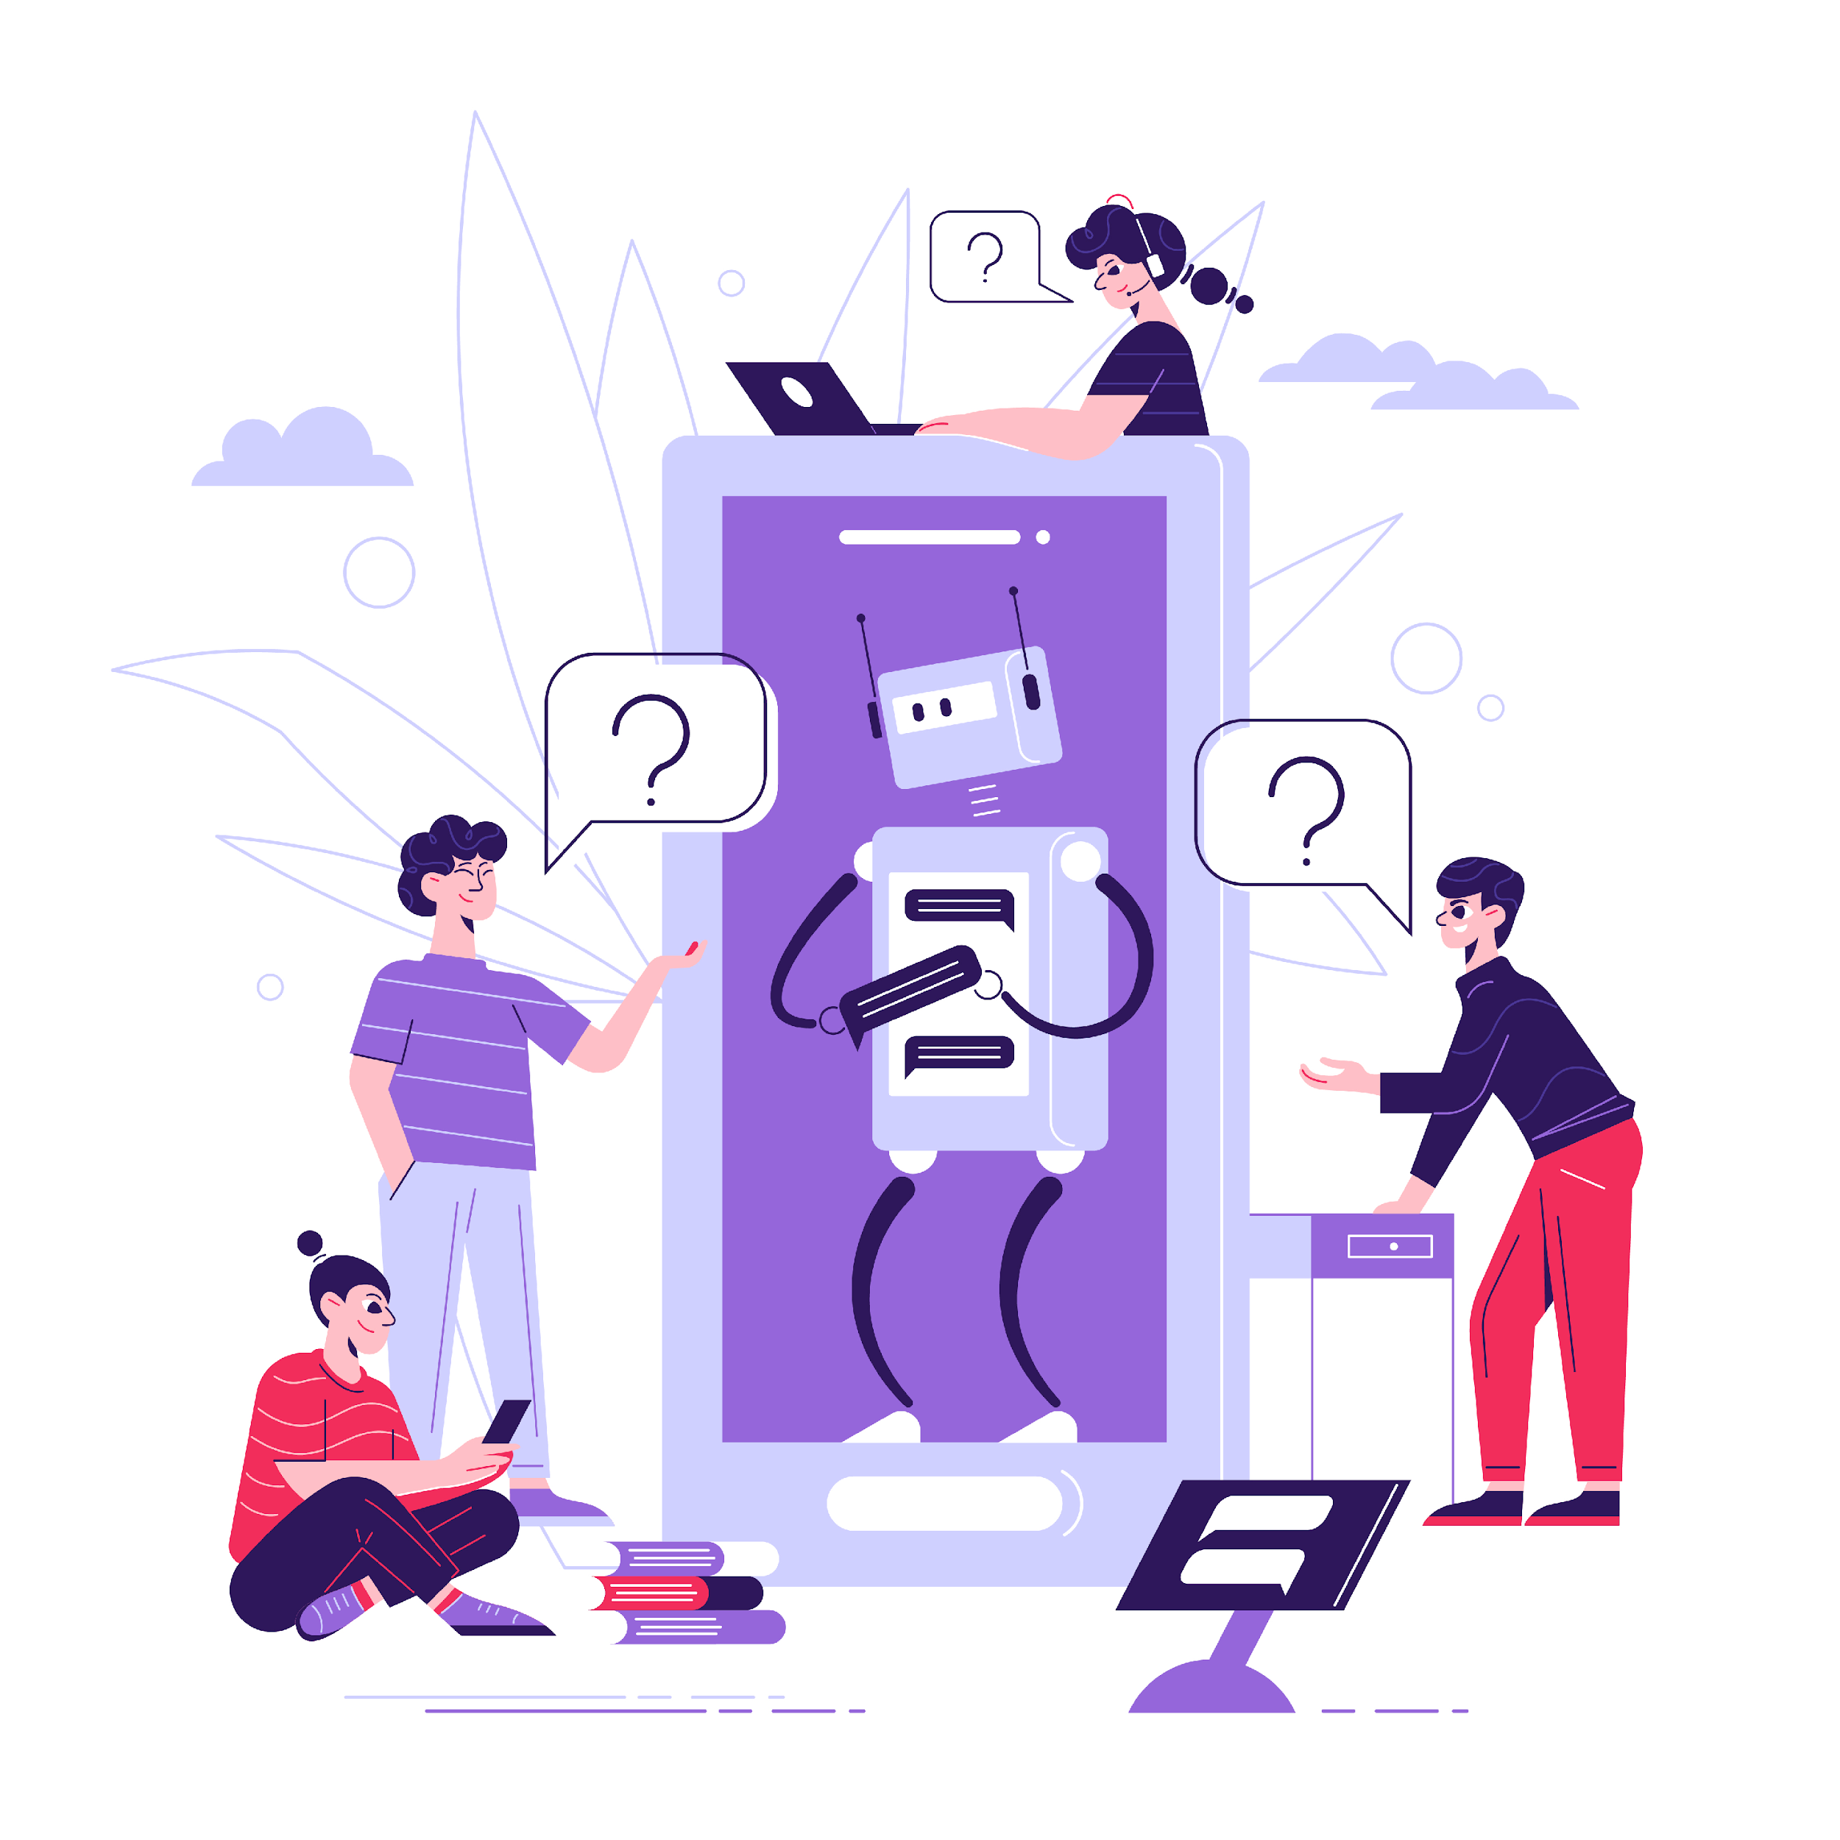
Using AI to Support Learning Design
Artificial intelligence (AI) can support educators in designing digital learning experiences by assisting with planning, adaptation, and idea generation. In this unit, AI is presented as a supportive tool that enhances, but does not replace, pedagogical decision-making.
AI tools can help generate lesson outlines, propose examples or discussion prompts, simplify complex language, and suggest alternative explanations tailored to different learner profiles. For self-directed learning materials, AI can also support the creation of reflective questions or practice activities.
It is essential that educators critically review all AI-generated content for accuracy, relevance, and inclusiveness. Pedagogical control remains with the educator, who decides what to use, adapt, or discard.
Adult learners benefit when AI-supported materials remain clear, practical, and connected to real-life contexts. Educators are encouraged to start with small, purposeful uses of AI aligned to clear learning objectives and ethical guidelines.
Image by Freepik

Slide 9
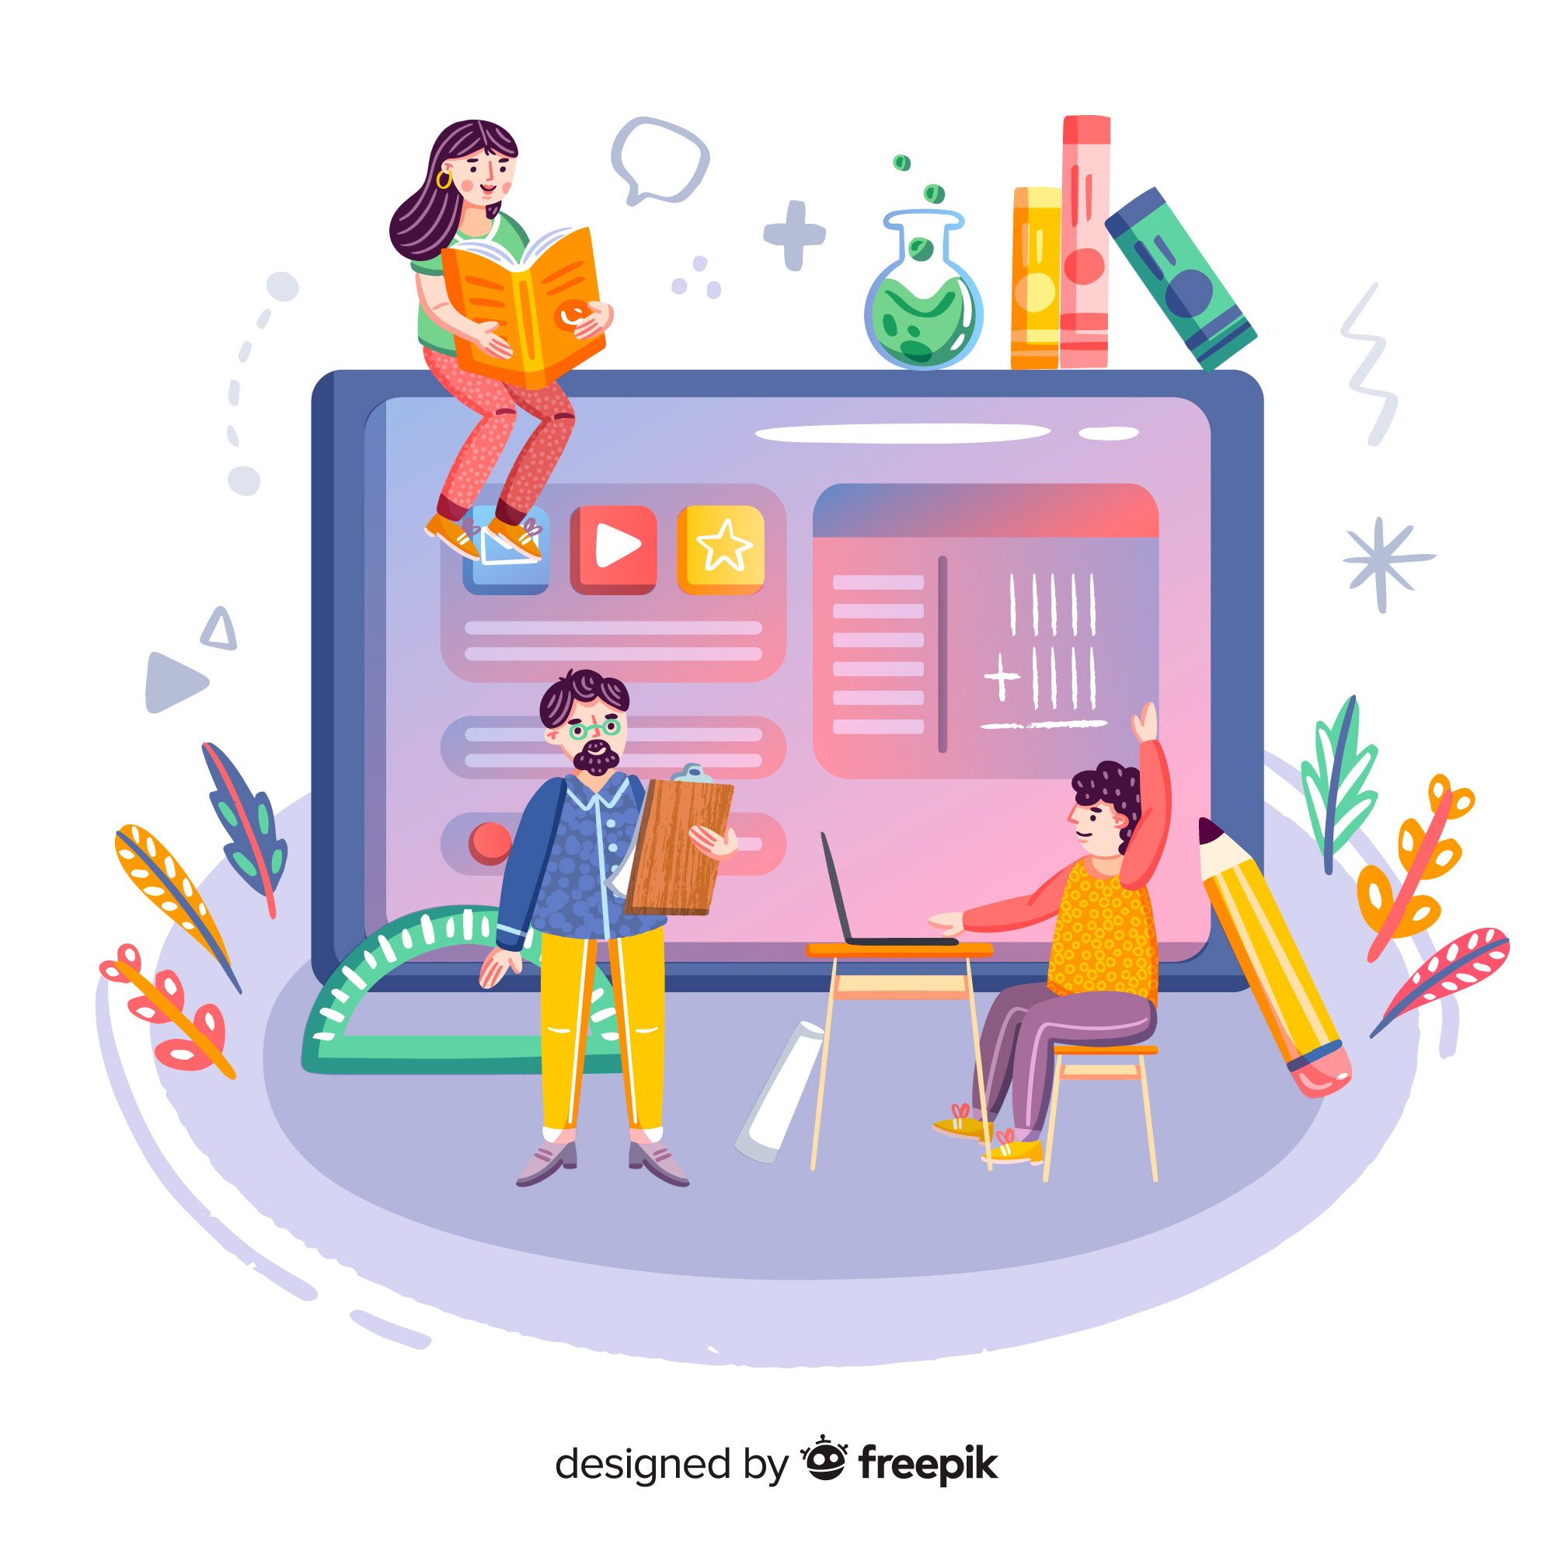
Case Study - Digital Course Redesign at Volkshochschule Vienna (VHS Wien)
Designing Content-Aligned
Digital Learning Experiences
This case study examines how Volkshochschule Vienna (VHS Wien) adapted several subject-based adult education courses into blended and digital formats to meet learners’ changing needs. Many VHS courses traditionally relied on face-to-face teaching, printed materials, and instructor-led explanations. As demand for flexibility increased, educators needed to redesign courses while maintaining content quality, relevance, and accessibility.
The key challenge was to adapt existing learning materials into digital formats that supported subject understanding without overwhelming learners or losing pedagogical clarity. By applying Content Knowledge (CK) and Technological Content Knowledge (TCK), educators ensured that digital tools supported learning objectives and reflected adult learners’ real-life contexts.
Goal: Strengthen subject learning through carefully selected and adapted digital resources.
Image by pikisuperstar on Freepik

Slide 10

Case Study - Digital Course Redesign at VHS Wien
Actions taken:
Core subject learning objectives were clearly defined before selecting digital tools
Existing course materials were adapted into digital formats rather than recreated
Short instructional videos were used to explain key concepts
Learning materials were organised in the VHS learning platform for self-paced access
Collaborative documents supported shared exercises and peer exchange
Open Educational Resources (OER) were adapted to local language and context
Accessibility measures were applied (clear structure, simple language, subtitles)
Educators used digital tools selectively to support understanding, not replace teaching
Image by pch.vector on Freepik

Slide 11

Case Study - Digital Course Redesign at VHS Wien
Impact
Improved flexibility for adult learners balancing work and family responsibilities
Clearer structure and better access to learning materials
Increased learner confidence in engaging with digital resources
Educators reported greater confidence in adapting content digitally
Tips from VHS Educators
Start with content goals, then choose digital tools
Adapt existing resources instead of creating everything from scratch
Keep digital materials simple, structured, and accessible
Design resources that respect adult learners’ experience and pace
Source:
This case study is based on publicly available information and documented practices curated from VHS Wien, www.vhs.at: Digital learning and blended course development.
Image by vectorjuice on Freepik

Slide 12

Activity 1. Analysing Your Current Digital Learning Design
Reviewing Content and Digital Resource Use
This activity invites you to reflect on how you currently design digital learning experiences in your teaching or training practice. You will analyse one existing lesson, module, or learning activity to understand how well your content, pedagogy, and digital resources are aligned.
The focus is on identifying whether digital tools genuinely support subject understanding and adult learners’ needs, or whether they are used mainly for convenience or delivery.
Goal: Gain clarity on your current practice and identify opportunities to improve how digital resources support learning content.
Suggested time: 45 minutes
Image by vectorjuice on Freepik

Slide 13
Activity Reviewing and Mapping Your Practice (45 minutes)
Step 1 – Select a learning activity
Choose one lesson, module, or learning activity you currently deliver.
Step 2 – Map your current design. Reflect on the following:
Content Knowledge (CK):
What key knowledge, skills, or concepts are learners expected to understand or apply?
Pedagogical approach:
How is learning organised (discussion, case study, practice task, self-study)?
Digital resources used:
What digital materials or tools are currently used (videos, LMS content, documents, quizzes)?
Step 3 – Reflect on improvement opportunities
Consider:
Do the digital resources support understanding of the content?
Are they accessible and appropriate for adult learners?
Could they be adapted to increase engagement, relevance, or flexibility?

Slide 14
Activity 2. Designing an Improved Digital Learning Resource
Applying Improvements Through Digital Tools
In this activity, you will design or adapt a small digital learning resource based on the reflections from Activity 1. The focus is on improving content delivery and learner experience, not on creating complex materials.
You will select one digital or AI-supported tool that clearly supports your learning objective and adult learners’ needs.
Goal: Create a simple, content-aligned digital learning element that can be used in real practice.
Suggested time: 45 minutes

Slide 15
Activity Build, Explain, and Reflect (45 minutes)
Step 1 – Choose one improvement to implement. Examples:
A short explainer video or presentation
An adapted OER with simplified language
A collaborative document with guiding questions
An AI-supported outline or example set (reviewed and adapted by you)
Step 2 – Create a simple prototype. Focus on:
Clear structure
Alignment with learning goals
Accessibility and clarity for adult learners
Step 3 – Explain your design choices. Briefly describe:
Learning goal supported
Why this digital tool fits the content
How it improves learner engagement or understanding
Step 4 – Quick reflection. Ask yourself:
Does this resource support content learning?
Is it practical and usable for adult learners?
What would you improve before using it?

Slide 16
Tips for Educators
Tip 1: Start with content, not tools
Begin by clearly defining what adult learners should understand or be able to do. Select digital tools only after clarifying learning goals, ensuring technology supports subject understanding rather than distracting from content or adding unnecessary complexity.
Tip 3: Design for clarity and accessibility
Structure digital materials clearly, using simple language, consistent layouts, and clear instructions. Include scaffolding such as examples, prompts, or checklists to ensure adult learners with different backgrounds can engage confidently and independently.
Tip 2: Adapt before you create
Before creating new materials, explore existing digital resources or open educational resources. Adapting proven content saves time, improves quality, and allows you to tailor materials to learners’ contexts, language levels, and real-life applications.
Tip 4: Use AI as support, not replacement
Use AI tools to support idea generation, examples, or lesson planning, but always review and adapt outputs. Educators remain responsible for accuracy, relevance, ethics, and pedagogical decisions in all learning materials.

Slide 17




Additional Resources
Blog - Boosting Adult Learning with Artificial Intelligence and Gamification
List of Tools - AI Tools: Learning, Skills and Training Tools
Article - Making technology work for adult learners: our 6 key research findings
EdTech Tutorials - Designing effective digital learning journeys

Slide 18
Assessment
Multiple Choice Style Question:
Q1: When adapting a face-to-face lesson for digital delivery, what should an educator decide first?
What learners need to understand or be able to do
Which digital platform is easiest to use
How much content can be automated
Which tools other educators are using
Reason: Designing digital learning experiences should always begin with clear learning objectives. Content goals guide all later design and technology decisions.

Slide 19
Assessment
Multiple Choice Style Question:
Q2: Which example best demonstrates good digital learning design for adult learners?
Uploading long lecture recordings without interaction
Breaking content into short units with examples and reflection prompts
Using multiple tools in every lesson
Replacing activities with automated quizzes
Reason: Well-designed digital learning for adults supports focus, flexibility, and reflection by structuring content into manageable, meaningful learning units.

Slide 20
Assessment
Multiple Choice Style Question:
Q3: What is the primary purpose of using technology when designing digital learning experiences?
To modernise teaching appearance
To reduce educator involvement
To support understanding and application of content
To assess learners automatically
Reason: Technology should enhance how learners understand and apply subject content, not serve as a substitute for pedagogy or educator expertise.

Slide 21
Assessment
Multiple Choice Style Question:
Q4: Which practice best supports accessibility and inclusion in digital learning design?
Using advanced tools with many features
Providing the same content format for everyone
Relying only on text-based materials
Offering clear structure, simple language, and adaptable resources
Reason: Accessible digital design considers diverse learner needs through clarity, flexibility, and adaptable materials that support different learning preferences.

Slide 22
Assessment
Multiple Choice Style Question:
Q5: What is an effective way to use AI when designing digital learning materials?
Using AI to suggest examples or lesson outlines that you adapt
Publishing AI-generated content without review
Allowing AI to determine learning outcomes
Replacing educator-designed activities
Reason: AI can support idea generation and planning, but educators must always review, adapt, and take responsibility for learning design decisions.

Slide 23

Self-Reflection Questions
Q1: How intentionally do I design digital learning activities so that tools clearly support the subject content I want adult learners to understand?
Q2: In what ways do my digital learning materials respect adult learners’ experience while offering clear structure, accessibility, and practical relevance?
Q3: How do I balance experimenting with digital or AI-supported tools and maintaining control over learning goals, content quality, and pedagogy?
Image by jcomp on Freepik

Slide 24
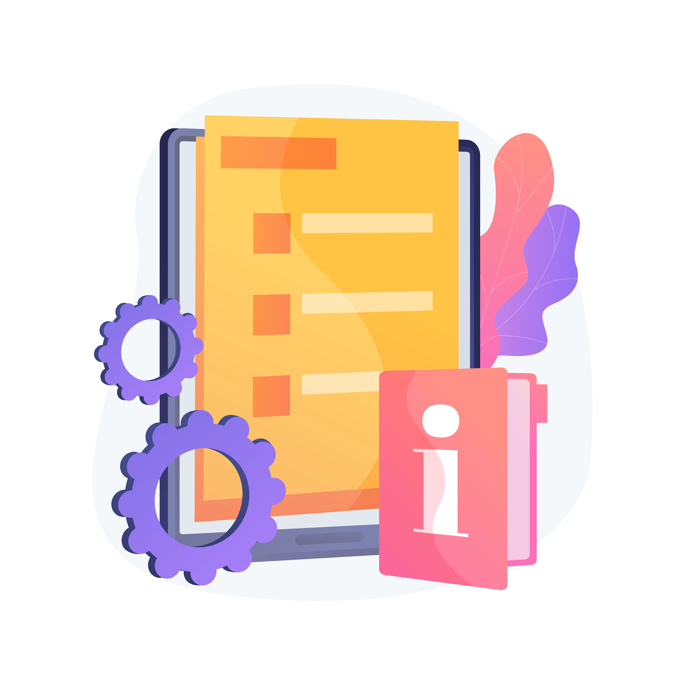
References
European Commission: Directorate-General for Education, Youth, Sport and Culture, Ethical guidelines on the use of artificial intelligence (AI) and data in teaching and learning for educators, Publications Office of the European Union, 2022, https://data.europa.eu/doi/10.2766/153756
OECD (2025), Education Policy Outlook 2025: Nurturing Engaged and Resilient Lifelong Learners in a World of Digital Transformation, OECD Publishing, Paris, https://doi.org/10.1787/c3f402ba-en
Kadry, S. (Ed.). (2024). Artificial Intelligence and Education - Shaping the Future of Learning. IntechOpen. doi: 10.5772/intechopen.1002135
Julia Rott, K., & Schmidt-Hertha, B. (2024). Transforming adult learning in the digital age: exploring environmental, content, and technological changes. International Journal of Lifelong Education, 43(4), 319–323. https://doi.org/10.1080/02601370.2024.2367395
Gul, A., & Bilgin, C. U. (2021). Gamification in adult learning. Research Anthology on Adult Education and the Development of Lifelong Learners, 905-932.
Image by vectorjuice on Freepik

Slide 25
Conclusion
Designing Digital Learning Experiences in Adult Education
Designing effective digital learning experiences begins with clear content goals and a deep understanding of adult learners’ needs and experiences. Digital tools and AI should be chosen purposefully to support subject understanding, not to add complexity or replace pedagogy.
Start small by adapting existing materials and experimenting with one digital or AI-supported tool at a time. Focus on clarity, accessibility, and real-world relevance to help learners engage confidently and independently.
Digital technologies can enrich learning by supporting exploration, collaboration, and flexible pathways, but your role as an adult educator—to guide, scaffold, and contextualise learning—remains essential.
Reflect regularly on what works, adapt based on learner feedback, and design every digital experience with intention and care.
“Technology will not replace great teachers, but technology in the hands of great teachers can be transformational.”
- George Couros

Slide 26

Congratulations on completing Unit 2: Designing Digital Learning Experiences
Image by pch.vector on Freepik

Slide 27






Project partners:
Project n° 2024-1-AT01-KA220-ADU-000254167
„Funded by the European Union. Views and opinions expressed are however those of the author(s) only and do not necessarily reflect those of the European Union or OeAD-GmbH. Neither the European Union nor the granting authority can be held responsible for them.“

