Slide 1







Innovating Teaching and Learning
Applying TPK, TPACK & Teaching and Learning
Project n° 2024-1-AT01-KA220-ADU-000254167

Slide 2
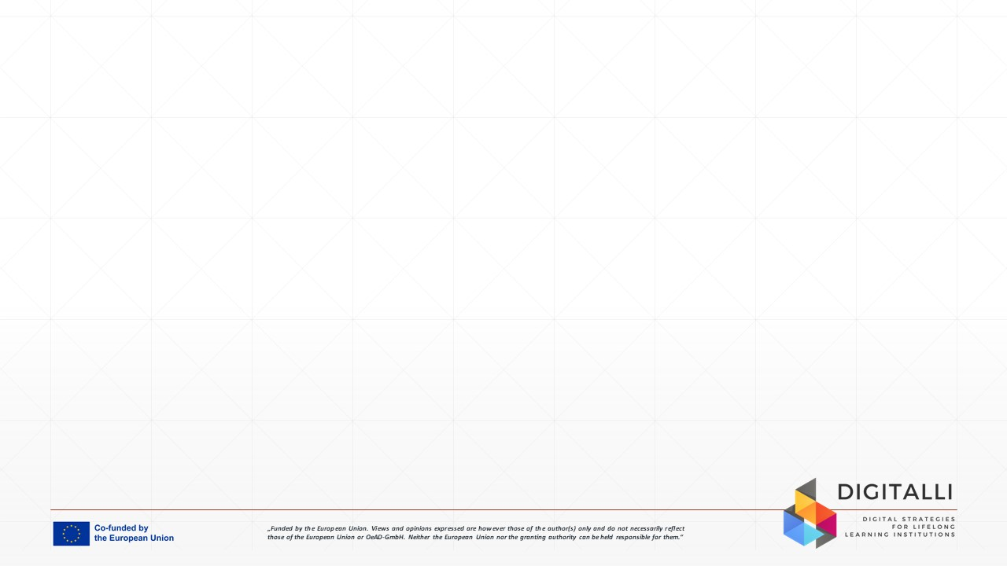

Unit Aim
The goal of this unit is to supply adult educators and trainers with the knowledge, skills, and confidence to design and deliver innovative, technology-empowered learning experiences.
You’ll learn about the TPACK framework and discover new digital teaching methods. These methods focus on collaboration and real-world applications. The aim is to help you design interactive and engaging environments where adult learners can thrive, encouraging their independence and practical skill development.
Image by rawpixel.com on Freepik

Slide 3

Learning Outcomes
After completing this SDL unit, you will have gained the following knowledge, skills and attitudes:
LO 1: Understand and apply TPACK and emerging digital pedagogies to design meaningful, technology-enhanced learning experiences.
LO 2: Integrate tools, strategies, and real-world tasks to facilitate collaborative, autonomous, and learner-centred environments.
LO 3: Demonstrate an innovative and reflective mindset as an educator by embracing experimentation, creative risk-taking, and the evolving role of digital teaching.
Image by vectorjuice on Freepik

Slide 4
Unit Overview
Understanding TPK & Emerging Digital Pedagogies
Digital tools as enablers of active learning, collaboration, and differentiation.
Emerging methods: microlearning, adaptive learning, AI-assisted feedback, immersive learning (AR/VR).
Considering adult learners’ autonomy, relevance, and experience.
Technology-Enhanced Collaborative & Problem-Based Learning
Digital platforms for co-construction of knowledge (Miro, Padlet, Google Workspace, Microsoft Loop).
Tools for collaborative inquiry and problem-solving.
Facilitating group dynamics online and scaffolding independent learning.
Applying the TPACK Framework in Course Design
Mapping your own CK (Content Knowledge), PK (Pedagogical Knowledge), and TK (Technological Knowledge).
Designing lessons where technology supports, not replaces, pedagogy.
Balancing learning outcomes with the affordances and constraints of tools.
Designing Interactive, Real-World Digital Learning Experiences
Real-world tasks: simulations, digital case challenges, scenario-based learning, workplace-relevant projects.
Using multimedia and multimodal resources to increase engagement.
Creating self-directed pathways with choice boards, branching activities, or AI-guided tutorials.

Slide 5

Understanding TPK and Emerging Digital Pedagogies
Technological pedagogical knowledge (TPK) describes relationships and interactions between technological tools and specific pedagogical practices. (Kurt, 2018)
Digital tools enable active learning, collaboration, and differentiation. Some examples include Padlet for brainstorming, Mentimeter for polls, Google Docs or Miro for co-creation, and learning management systems that adapt content for individual learners.
Examples of emerging methods include microlearning, like short video tutorials or H5P mini-lessons, adaptive learning platforms like Magicschool or Eduaide that adjust to learner progress, as well as AI-assisted feedback through tools like ChatGPT or automated quizzes and immersive learning with AR or VR simulations for practice-based skills.
Adult learners benefit when learning experiences provide autonomy through flexible pacing and choice by connecting content to real-world tasks, and opportunities to draw on prior knowledge and share experiences with peers. (Green, 2024)
Educators should start small by integrating one tool or method per module, aligning it with a clear learning goal and gathering feedback to refine the approach.
Image by Freepik

Slide 6

Applying the TPACK Framework in Course Design
1. Map your knowledge
Content knowledge (CK) is what you teach, for example, adult literacy or workplace skills.
Pedagogical knowledge (PK) is how you teach, such as collaborative learning or problem-based learning. (Koehler & Mishra, 2009)
Technological knowledge (TK) is the tools you use (Koehler & Mishra, 2009), like interactive whiteboards, Zoom breakout rooms, and/or Google Docs. For example, an adult ESL (English as a second language) lesson may combine knowledge of grammar, strategies for adult engagement, and language-learning apps.
2. Integrate technology thoughtfully by considering the following:
Use technology to enhance learning rather than replace pedagogy. For example, use a quiz app (Genially, H5P) to reinforce content after a discussion instead of letting the app teach the lesson.
Balance learning goals and tool affordances.
Choose tools that align with learning outcomes and learner needs. For example, in a skills workshop, interactive simulations may work better than a slideshow because they allow adults to practice in a safe environment.
3. Reflect on each lesson by asking yourself whether the technology you used supported understanding, collaboration, or engagement, or if it added unnecessary complexity.
Image by lexamer on Freepik

Slide 7

Technology-Enhanced Collaborative and Problem-Based Learning
Use digital platforms for co-construction of knowledge. Tools like Miro, Padlet, Google Workspace, and Microsoft Loop let adults brainstorm, organise ideas, and create shared products. For example, learners map steps for a workplace safety protocol in Miro, adding images, notes, and links in real time.
Guide learners to implement tools for collaborative inquiry and problem solving. Discussion boards, shared documents, and case-based learning platforms support investigation, comparison of ideas, and joint decision-making. For example, a group uses Google Docs to analyse a customer service scenario, identify root causes, and propose solutions together.
Manage group facilitation dynamics online. Clear roles, turn-taking protocols, breakout room prompts, and rotating responsibilities help maintain engagement and accountability. For example, assigning facilitator, recorder, and presenter roles during an online project helps adults stay focused and share ownership.
Ensure scaffolding of independent learning within groups. Provide templates, guiding questions, checklists, and short how-to videos so learners can contribute confidently and stay on task. For example, a Padlet with step-by-step prompts guides individuals through early research before they return to group problem-solving.
Image by pikisuperstar on Freepik

Slide 8
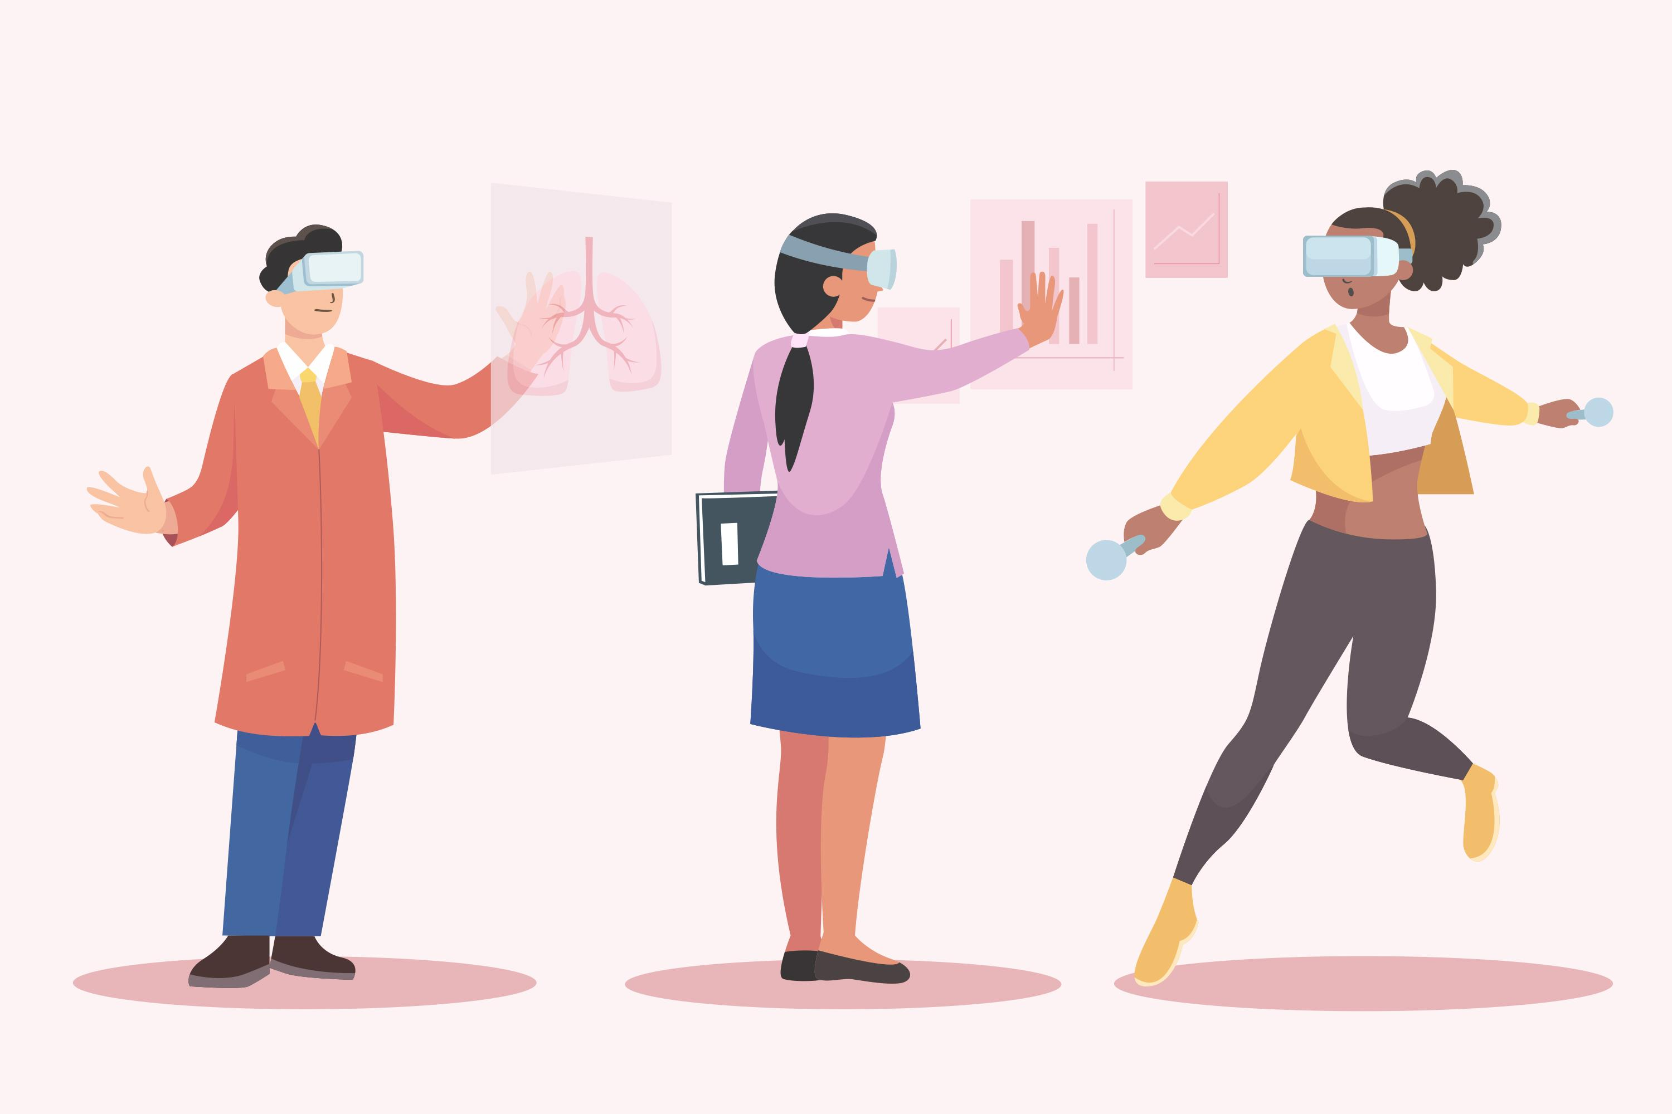
Designing Interactive, Real-World Digital Learning Experiences
Implement real world tasks that build transferable skills. Simulations, digital case challenges, scenario-based activities, and workplace-relevant projects help adults apply knowledge immediately. For example, learners could practice responding to a workplace task in an online branching scenario that changes based on their decisions. See an example of a branching scenario created on Genially.
Use multimedia resources to increase engagement. Short videos, audio clips, infographics, interactive charts, and virtual tours support diverse learning preferences and keep learners motivated. (Katona, Venkataragavan, Erlandsson, Burmann, & Oparina, 2023)
Support autonomy with structure by providing clear goals, success criteria, time estimates, and checkpoints so learners can navigate flexible pathways confidently. For example, an AI-guided tutorial offers hints or suggests review materials only when the learner requests support. This can be seen in action in the language learning tool Duolingo, where if you make mistakes repeatedly, it doesn’t immediately force a review. Instead, it waits for you to request help by clicking the ‘tip’ or ‘hint’ button.
Image by Freepik

Slide 9

Case Study - Course Adaptation in DCU (Dublin City University)
Engaging Students Through Asynchronous Teaching
This case study explores how a highly interactive, practice-focused Religious Education module was transformed into a fully asynchronous online experience.
When face-to-face teaching was no longer possible in Semester 1 of the 2020/2021 academic year, the tutor had to rethink his approach to keep things practical, focused on students, and engaging. He embraced TPK and TPACK principles to ensure that learning remained meaningful and interactive, even in a virtual setting.
Previously, small-group seminars were the centre of the module, giving students hands-on experience with the Catholic Primary Religious Education Curriculum and the Grow in Love programme.
The challenge was to rebuild the rich, collaborative environment online.
The goal was to ensure meaningful interaction and feedback.
Image by rawpixel on Freepik

Slide 10

Case Study - Course Adaptation in DCU
Actions taken:
Lectures were pre-recorded and published on Loop (the Virtual Learning Environment - VLE).
Weekly structure consisted of contextualising videos from the lecturer, readings, and practice quizzes.
Instead of live small-group seminars, the RE teaching team recorded group discussions (on Zoom), embedded them in Loop, and created H5P interactive activities for reflection.
After interacting with H5P tasks, students posted reflections in discussion forums.
Guest speakers were involved via Zoom interviews with practitioners in Catholic primary education (teachers, principals, trustees) and embedded in the course.
Multiple modalities (video, audio, text), subtitling, consistent page design, weekly communications, drop-in clinics (and recordings of those clinics).
The traditional 2,000-word essay was replaced with a three-part e-portfolio using Loop Reflect. Students submitted artefacts + reflections + meta-reflection; multimedia allowed.
Image by studio4rt on Freepik

Slide 11

Case Study- Course Adaptation in DCU
Impact:
Higher interactivity, more student involvement.
Rich and meaningful forum contributions; students had time to reflect deeply.
Creative, individual, and interesting e-portfolio submissions; the lecturer found it personally rewarding.
The lecturer modelled good technological-pedagogical practice.
Tips from the lecturer:
Be consistent with your structure, stick with your plan, so students know what to expect.
Know your learners’ needs, learning styles, and challenges.
Design your VLE page (Loop) thoughtfully by using a clear layout, weekly release of content, not just a file dump.
Use CPD (professional development) supports, like those from the Teaching Enhancement Unit.
Let students make choices in assessments, but give them clear instructions and support.
Image by Freepik

Slide 12
Activity 1
Applying the TPACK Framework to Re-Design a Current Lesson/Course
During this activity, you will get to analyse your current teaching practice through the lens of TPACK and identify opportunities to enhance learning using purposeful, pedagogically aligned technology.
Instructions:
Step 1. Select one lesson/session/module you currently teach. Choose something you deliver regularly and know well - for example, an adult literacy lesson, an induction session, a workplace skills activity, or an ESL grammar workshop.
Image by vectorjuice on Freepik

Slide 13
Activity Applying the TPACK Framework to Re-Design a Current Lesson/Course (45 minutes)
Step 2. Map your current practice using the TPACK framework. Use the below to identify what you currently do:
Content Knowledge (CK): What core knowledge, skills, or concepts does the lesson focus on?
Pedagogical Knowledge (PK): How do you teach it? (group discussion, problem-based learning, demonstrations, collaborative activities)
Technological Knowledge (TK): What tools - if any - do you currently use? (Padlet, Zoom breakout rooms, Google Docs, H5P, Mentimeter)
Step 3. Analyse gaps and opportunities for improvement. Reflect on:
Which elements of TPACK are strong? Which are underdeveloped?
Is the technology you currently use adding value, or just adding complexity?
Could technology help make the learning more: interactive, collaborative, differentiated, accessible, practical or real-world?
Use these reflective questions:
How could digital tools enhance the understanding or practice of the content?
How could pedagogy and technology work together more effectively?
Where might learners benefit from more autonomy, choice, or adaptation?
Step 4. Create a short redesign summary.
Write a brief outline of how you would redesign the lesson/module by integrating TPACK more intentionally. Include:
Revised learning outcomes (if needed).
Pedagogical strategies you will underscore (collaborative inquiry, microlearning, problem-solving).
Digital tools you will add or remove, and the reason for each (Padlet for initial brainstorming, H5P for practice quizzes, Google Docs for co-creation, AI-assisted feedback tool for formative support).
How these choices improve learner engagement, autonomy, and/or relevance.
Potential challenges & how you will address them.

Slide 14
Activity 2
Implementing Your TPACK - Aligned Changes Using Digital Tools
Let’s put your redesigned ideas into action by creating an example activity/resource using at least one digital tool aligned with your learning goals and pedagogical approach.
Instructions:
Step 1. Choose one element from your redesign to implement. For example:
A collaborative brainstorming task using Padlet or Miro
A short microlearning video or H5P mini-lesson
An interactive branching scenario in Genially
An AI-supported feedback prompt using ChatGPT or Eduaide
A co-created Google Doc template for group problem-solving
A short adaptive learning task using MagicSchool or a similar tool
Pick something you can create a prototype for within the timeframe.

Slide 15
Activity Implementing Your TPACK - Aligned Changes Using Digital Tools (45 minutes)
Step 2. Build a small, functional prototype. Create a basic version that a learner could test. Examples:
A Padlet board with instructions and sections
A 3–5 screen H5P interactive element (quiz, flashcards, hotspot, drag & drop)
A Google Doc with guiding questions and scaffolds
A short AI-generated explanation or feedback template
A Miro board with the structure of an activity
A Genially branching scenario with 2 - 3 decision points
Focus on clarity, alignment with learning outcomes, accessibility, and ease of use.
Step 3. Write a short explanation for your prototype planning. Explain the following:
Learning goal: What skill or knowledge does this prototype support?
Pedagogical approach: How does this tool support your chosen strategy (problem-based learning, collaborative learning, inquiry, microlearning)?
TPACK alignment:
o How does technology enhance - not replace - your pedagogy?
o Why is this particular tool a good fit?
Learner experience:
o How does the activity promote engagement, autonomy, relevance, or reflection?
o What scaffolding did you include (templates, prompts, how-to instructions)?
Step 4. Evaluate your prototype using a quick reflection checklist:
Does the technology meaningfully support the learning outcome?
Is the activity intuitive and accessible for adult learners?
Does it encourage interaction, collaboration, or problem-solving?
Does it reflect the improvements from Activity 1?
What small changes would you make before using it with real learners?

Slide 16
Tips for Educators
Tip 1: Start with pedagogy, not technology
Before selecting a tool, it's important to clarify the desired learning outcomes and the type of learner experience you wish to create. Choose a technology that enhances this experience rather than detracts from your teaching goals. This approach ensures that learning remains meaningful, structured, and aligned with the TPACK principles.
Tip 3: Design for autonomy with clear scaffolding
Provide choices, flexible pacing, and opportunities for learner-led exploration, while pairing this with guidance such as templates, prompts, checklists, or short ‘how-to’ videos. This approach balances independence with structure and ensures that all learners can engage with confidence.
Tip 2: Integrate only one new tool or method at a time
Adult learners and educators benefit from gradual change. Introduce a single digital element, such as a Padlet brainstorm or an H5P quiz, and gather feedback. This approach builds confidence, reduces cognitive load, and supports sustainable innovation.
Tip 4: Experiment freely and model creativity
Encourage your learners to understand that digital teaching is all about curiosity, experimentation, and ongoing improvement. Be willing to explore new tools, collaborate on activities, and adjust your approach based on feedback. When educators show a readiness to innovate, it empowers learners to do the same.

Slide 17




Additional Resources
Article - Emerging technologies and adult learning: useful resources for educators
EdTech Tutorials - Compact video tutorials on how to integrate AI and other technology
Blog - Supporting Non-Traditional Learners Through Technology
List of Tools - Ten ICT Tools in Online Training for Adult Learning

Slide 18
Assessment
Multiple Choice Style Question:
Q1: Which statement best captures the purpose of the TPACK framework?
To help teachers choose the newest digital tools available
To ensure technology replaces traditional pedagogical approaches
To guide the integration of content, pedagogy, and technology for effective teaching
To evaluate student digital literacy levels
Reason: TPACK emphasises the intentional integration of content knowledge (CK), pedagogical knowledge (PK), and technological knowledge (TK) to design effective learning experiences. It is not about simply using new tools or replacing pedagogy.

Slide 19
Assessment
Multiple Choice Style Question:
Q2: Which of the following options most accurately represents technology-enhanced collaborative learning?
Learners reading digital textbook chapters individually
Learners using Miro to co-create a process map during a problem-solving task
Learners completing a timed online quiz alone
Learners watching a video lecture asynchronously
Reason: Collaborative learning involves students working together in groups to solve problems, complete tasks, or create a product. Using a digital tool like Miro for real-time, shared creation aligns with technology-enhanced collaboration and problem-based learning.

Slide 20
Assessment
Multiple Choice Style Question:
Q3: What is a key benefit of emerging digital tools such as adaptive platforms or AI feedback tools?
They replace the need for teacher planning
They ensure all learners complete tasks at the same speed
They eliminate the need for formative assessment
They allow learners to progress at their own pace and receive personalised support
Reason: Adaptive and AI-based tools offer personalised pathways that promote learner independence and provide customised feedback—essential principles in digital pedagogy and adult learning.

Slide 21
Assessment
Multiple Choice Style Question:
Q4: Which example best illustrates a genuine, real-world learning task?
Reading a chapter about customer service theories
Watching a video on workplace safety regulations
Completing a branching scenario where learners respond to an upset customer
Listening to a podcast about conflict resolution
Reason: Branching scenarios simulate real workplace challenges, requiring learners to apply skills, make decisions, and observe their consequences - essential to authentic adult learning.

Slide 22
Assessment
Multiple Choice Style Question:
Q5: What mindset encourages innovation and creative risk-taking in digital teaching?
Being open to testing new tools, reflecting, and adjusting based on learner feedback
Only using tools that educators already feel confident with
Avoiding student input during lesson design
Waiting for formal training before trying any new digital method
Reason: Innovation requires experimentation, reflection, and adaptability. Embracing new methods and adjusting them based on feedback encourages continuous improvement in digital pedagogy.

Slide 23

Self-Reflection Questions
Q1: Am I effectively combining content, teaching methods, and technology to create valuable learning experiences?
Q2: How am I helping adult learners gain independence through choices, flexibility, and tools, while still providing support for their success?
Q3: What risks or innovations am I willing to try in my digital teaching, and how can I model curiosity and continuous learning for my students?
Image by jcomp on Freepik

Slide 24
References
Green, D. N. (2024). Adult learners: Connecting andragogy and transformational leadership in the classroom. Business Ethics and Leadership, 8(4), 137–147. https://doi.org/10.61093/bel.8(4).137-147
Katona, B., Venkataragavan, J., Erlandsson, N., Burmann, U., & Oparina, B. (2023). Use of visual learning media to increase student learning motivation. World Psychology, 1(3), 89–105. https://doi.org/10.55849/wp.v1i3.381
Koehler, M. J., & Mishra, P. (2009). What is technological pedagogical content knowledge? Contemporary Issues in Technology and Teacher Education, 9(1). https://citejournal.org/volume-9/issue-1-09/general/what-is-technological-pedagogicalcontent-knowledge
Kurt, S. (2018, May 12). TPACK: Technological Pedagogical Content Knowledge Framework. Educational Technology. https://educationaltechnology.net/technological-pedagogical-content-knowledge-tpack-framework/
Image by vectorjuice on Freepik

Slide 25
Conclusion
Innovating Teaching & Learning in the Digital Age
Effective digital teaching is not about using technology for its own sake, but about thoughtfully integrating content, pedagogy, and tools to create meaningful learning experiences.
Start small, be willing to experiment, and let creativity guide your design.
Technology can empower learners to collaborate, explore, and apply knowledge in real-world contexts, but your role as an educator - to facilitate, scaffold, and inspire - remains central.
Embrace experimentation, reflect continuously, and place learners at the heart of every digital experience.
“Tell me and I forget. Teach me and I remember. Involve me and I learn.” - Benjamin Franklin

Slide 26

Congratulations on completing Unit 3: Innovating Teaching and Learning
Image by pch.vector on Freepik

Slide 27






Project partners:
Project n° 2024-1-AT01-KA220-ADU-000254167
„Funded by the European Union. Views and opinions expressed are however those of the author(s) only and do not necessarily reflect those of the European Union or OeAD-GmbH. Neither the European Union nor the granting authority can be held responsible for them.“

