Slide 1







Unit 5: Inclusive and Competence-Oriented Learning
Facilitating Learner Agency & Digital Competence in Adult Education
Project n° 2024-1-AT01-KA220-ADU-000254167

Slide 2
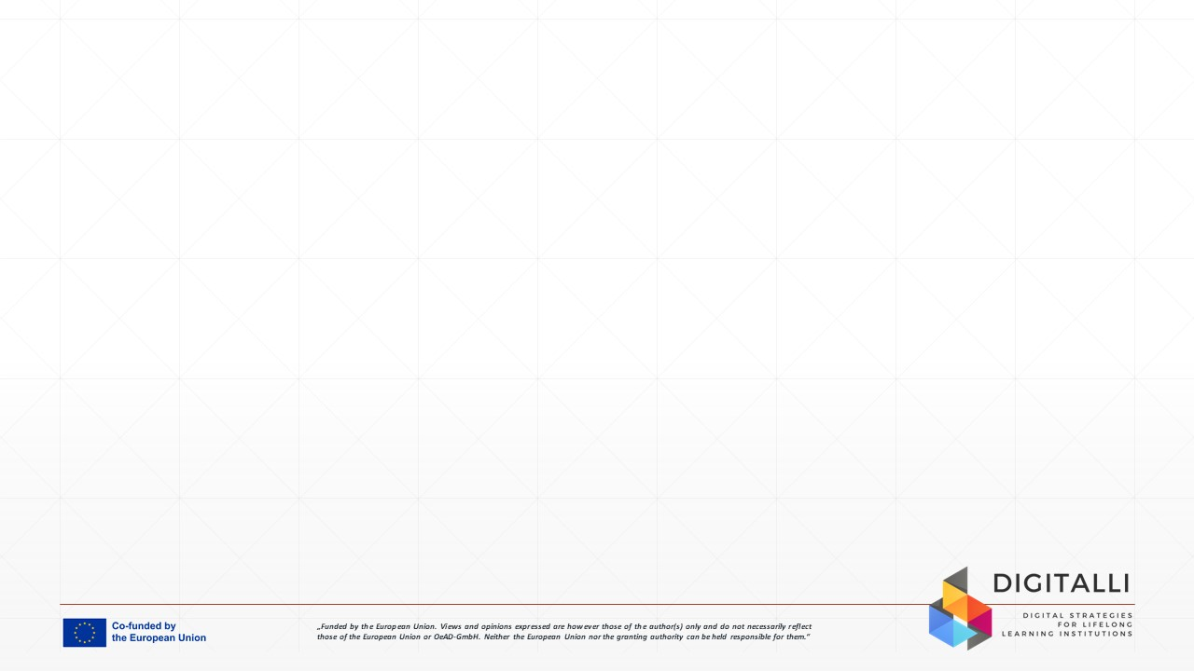

Unit Aim
The aim of this unit is to promote learner agency, equity, and digital competence through inclusive, student-centred digital pedagogy that empowers adults to become confident, autonomous and resilient users of technology for personal and professional development.

Slide 3

Learning Outcomes
After completing this SDL unit, you will have developed the ability to:
Facilitate digital learning that respects learner diversity
Empower adults to build and apply digital skills in real-world settings
Guide learners in developing personal digital transformation plans
Promote critical digital literacy and learner autonomy

Slide 4
Unit Overview
Critical Digital Literacy
Evaluating truth, information, and bias
Understanding algorithms and influence
Safe identity and data awareness
Emotional resilience and online wellbeing
Digital Inclusion & Equity
Understanding the digital confidence gap
Barriers: economic, cultural, linguistic, generational
Accessibility and universal design
Recognising structural disadvantage
Technology as a right, not privilege
Empowering Learner Autonomy and Self-Regulation
Goal setting and co-creating learning
Self-paced and self-directed models
Building confidence through small wins
Role of feedback and recognition
Competence-Oriented Learning
Moving beyond teaching tools → teaching transferable capacities
Real-life problem-solving
Project-based and contextual learning
Skills that support employability and lifelong learning
Digital Transformation Planning
Roadmap for change
Personal or institutional formats
Self-inventory → goal → step → outcome
Tracking micro-credentials and achievements

Slide 5

Case Study
Eleni — Returning to Work after 12 Years
37-year-old migrant mother
No formal digital qualifications
Fear of mistakes & judgment
Wants admin job but avoids digital systems
“I feel stupid online.”

Slide 6
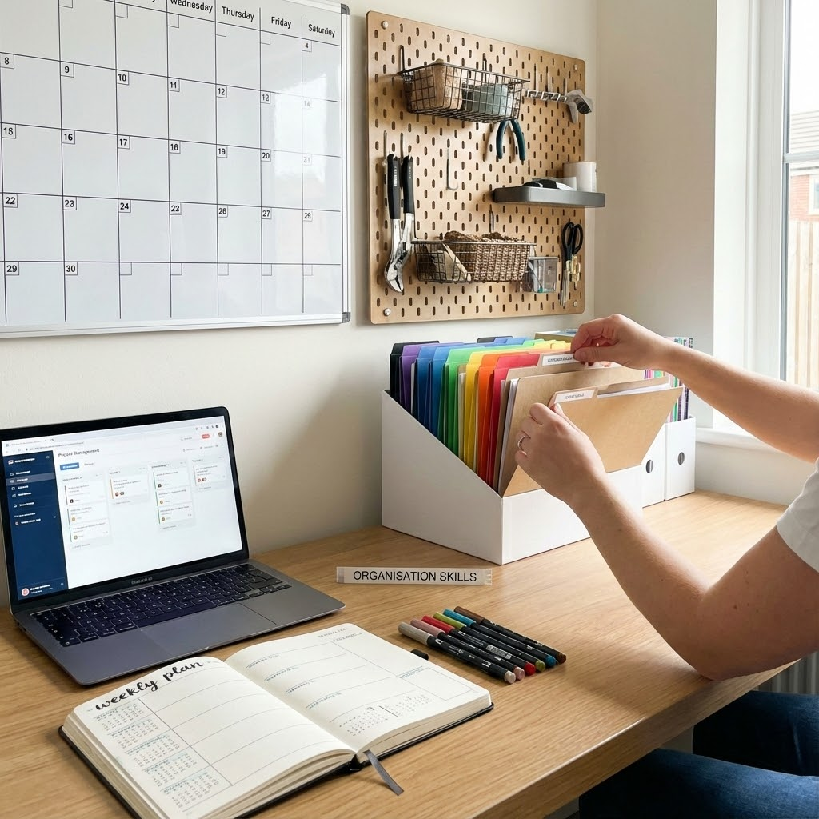
Case Study
Challenges
Confidence vs ability
Language & interface barrier
Limited devices at home
Not aware of free training
Opportunities
Strong organisational skills
Motivated for employment
Local support networks
Micro-learning & blended delivery

Slide 7

Case Study
Reflection questions:
What would empowerment look like for Eleni?
Which digital skills should be prioritised?
What role should the educator play? Trainer? Coach? Co-learner?
What biases might we have toward her?
What small win could be achieved in week 1?

Slide 8

Activity 1
Digital Competence Self-Inventory
Purpose: Identify readiness, needs and confidence levels.
Task:
→ Complete the Self-Inventory checklist
→ Highlight ONE strength & ONE priority
Outcome:
To build self-awareness and responsibility for learning direction.

Slide 9
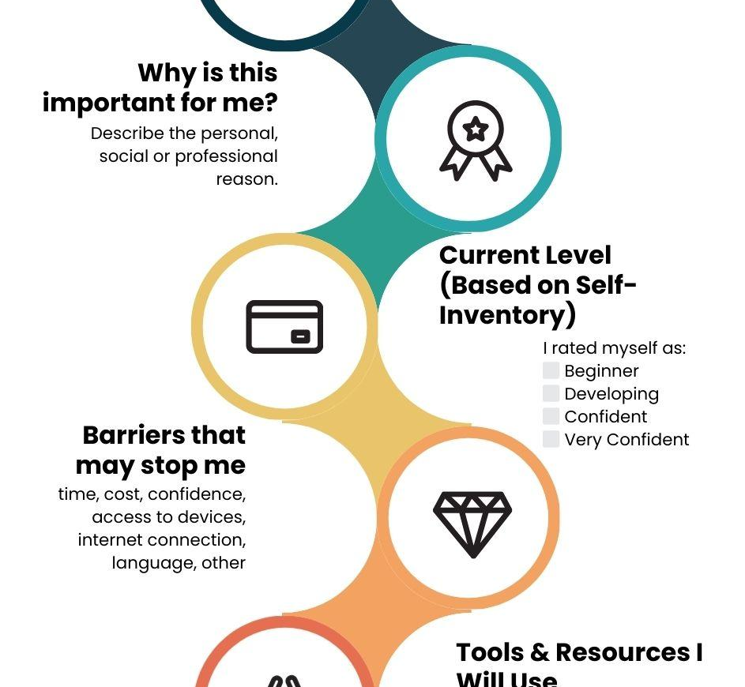
Activity
Personal Digital Transformation Plan
Personal Digital Transformation Plan
Task:
→ Complete Goals, Barriers, Resources and Action Steps
Outcome:
A personalised roadmap for digital growth connected to real life goals.
  The activity should take approximately 30 minutes.
Notes:
TIPS FOR EDUCATORS
Empower, don’t rescue
Focus feedback on progress, not perfection
Break tasks into visible micro-victories
Start with speaking & confidence before tools
Replace assumptions with questions

Slide 10
Tips for Educators
Empower, don’t rescue
Focus feedback on progress, not perfection
Break tasks into visible micro-victories
Start with speaking & confidence before tools
Replace assumptions with questions

Slide 11
Additional Resources
European Commission
2022
UNESCO
2021
OECD
2021
Redecker & Punie
2017
European Digital Competence Framework for Citizens (DigComp 2.2)
Reimagining Our Futures Together: A New Social Contract for Education
21st-Century Readers: Developing Literacy Skills in a Digital World
European Framework for the Digital Competence of Educators (DigCompEdu)

Slide 12

Assessment
Multiple Choice Question:
Q1. What is the primary goal of digital inclusion in adult education?
A) To ensure every learner owns the newest device
B) To replace face-to-face learning with online learning
C) To provide equal access, participation, and meaningful use for all learners
D) To limit technology to advanced learners only
Correct Answer: C
Reason: Digital inclusion focuses on enabling all learners to access and participate meaningfully and confidently, regardless of background or ability.
*Please highlight correct answer in green
** Please provide a reason for the correct answer

Slide 13
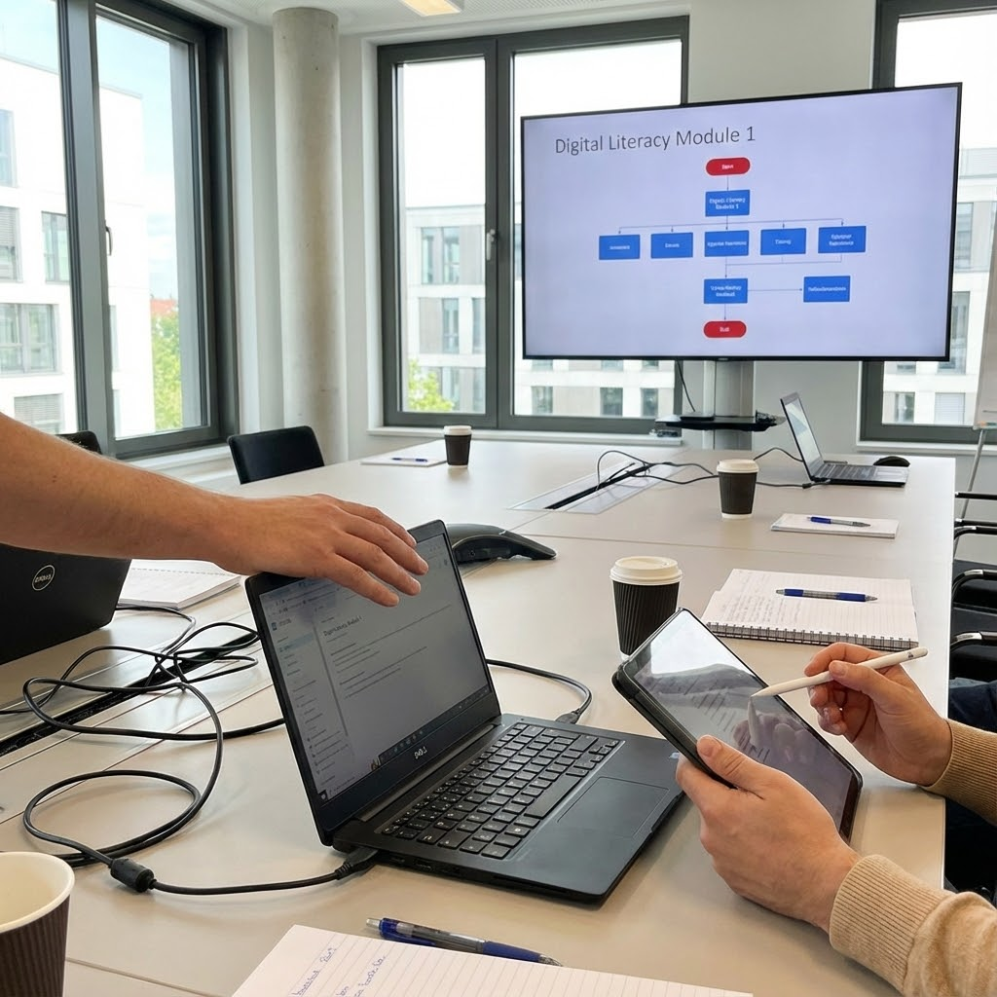
Assessment
Multiple Choice Style Question:
Q2. Competence-oriented learning prioritises:
A) Memorising tool features and menus
B) Developing transferable skills that can be applied to real-life situations
C) Completing tasks exactly the way the trainer demonstrates
D) Using as many tools as possible
Correct Answer: B
Reason: Competence-oriented learning emphasizes real-world application and capacity building, not tool memorization.

Slide 14
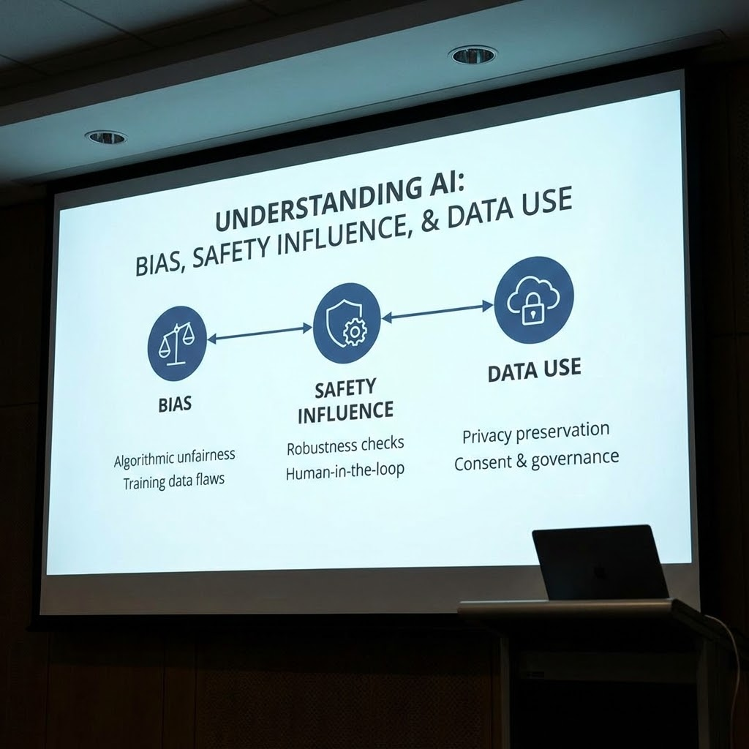
Assessment
Multiple Choice Style Question:
Q3. Critical digital literacy includes:
A) Trusting all online information equally
B) Assuming algorithms are neutral
C) Understanding bias, safety, influence, and data use
D) Avoiding social media entirely
Correct Answer: C
Reason: Critical digital literacy goes beyond technical skills to include awareness of information reliability, data privacy, influence, and digital wellbeing.

Slide 15
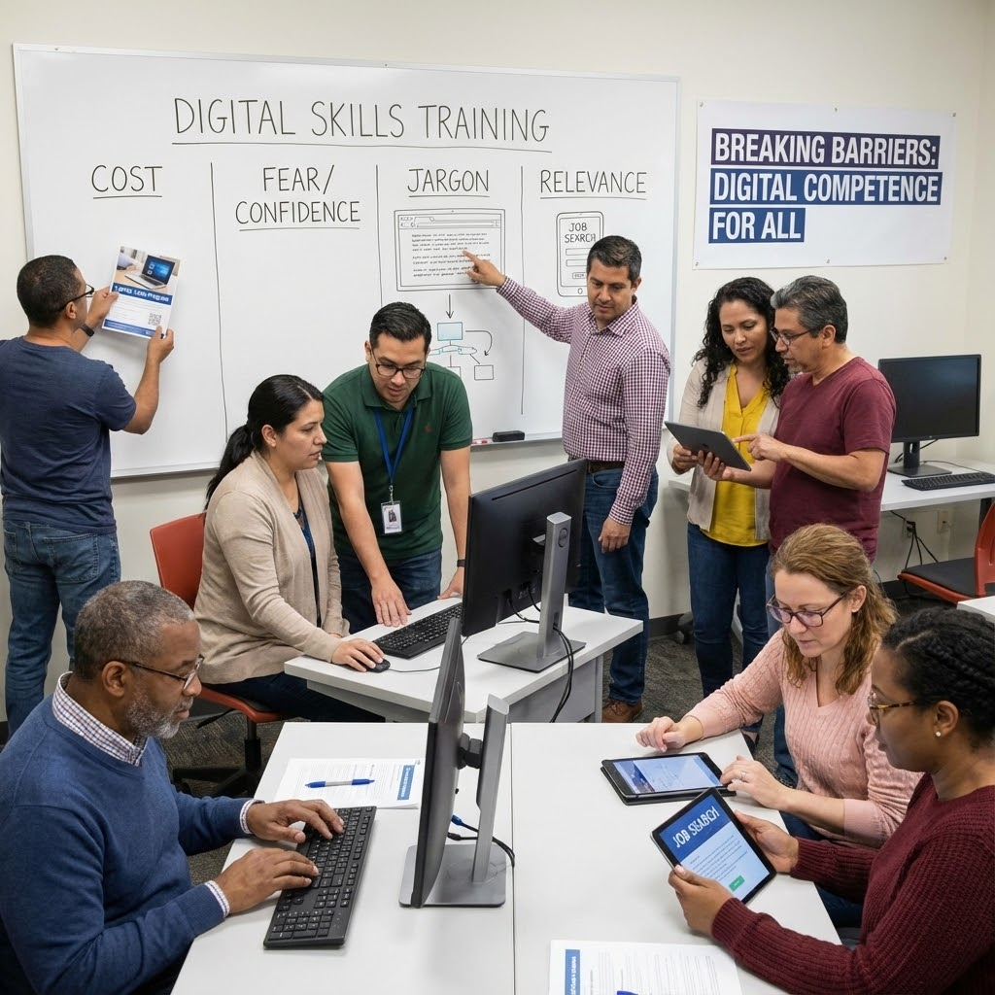
Assessment
Multiple Choice Question:
Q4. Which of the following is a common barrier to digital competence for adult learners?
A) Curiosity
B) Access to multiple devices
C) Lack of confidence or fear of making mistakes
D) Having too much support available
Correct Answer: C
Reason: Psychological barriers such as fear, embarrassment, or lack of confidence are among the most significant challenges adults face.

Slide 16
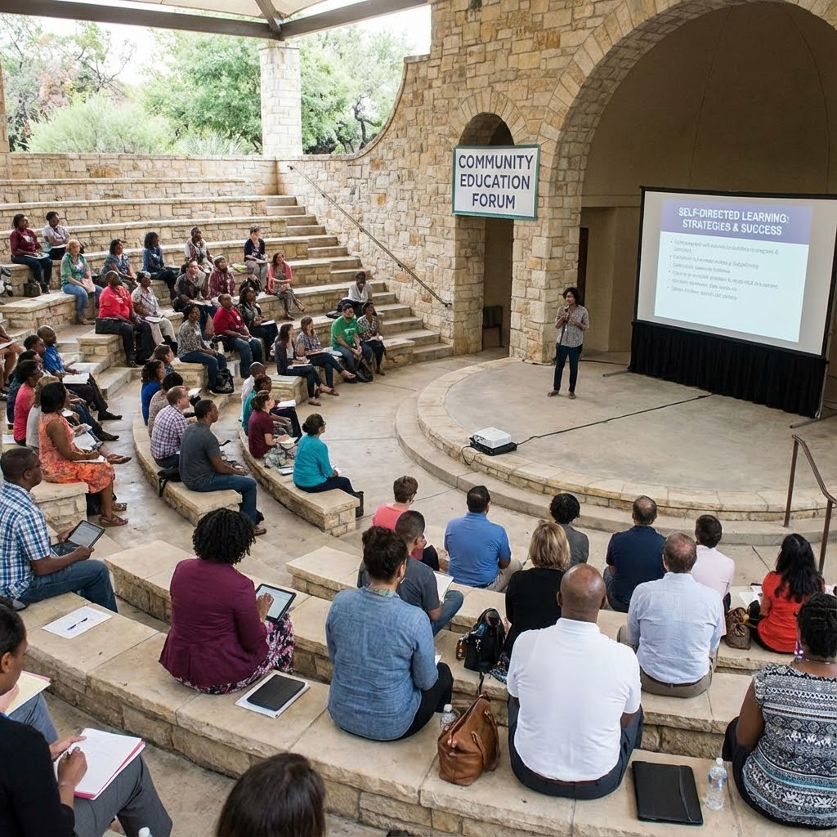
Assessment
Multiple Choice Style Question:
Q5. Personal Digital Transformation Plans empower learners by:
A) Telling them exactly what tools they must use
B) Making progress dependent on the educator
C) Encouraging ownership, goal-setting, and self-directed learning
D) Eliminating the need for feedback or support
Correct Answer: C
Reason: Action plans help learners take responsibility, set goals, and track progress, strengthening autonomy and confidence.

Slide 17
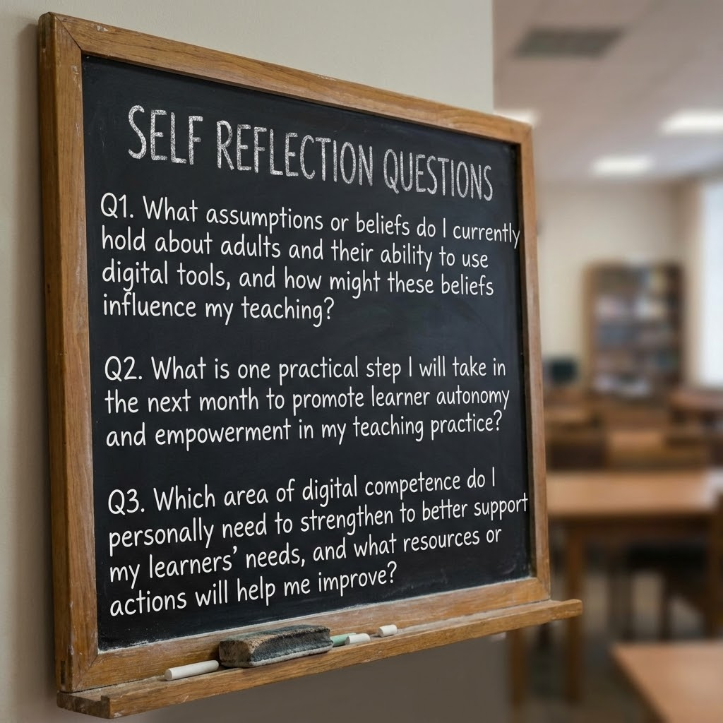
Self-Reflection Questions
Q1. What assumptions or beliefs do I currently hold about adults and their ability to use digital tools, and how might these beliefs influence my teaching?
Q2. What is one practical step I will take in the next month to promote learner autonomy and empowerment in my teaching practice?
Q3. Which area of digital competence do I personally need to strengthen to better support my learners’ needs, and what resources or actions will help me improve?

Slide 18

Conclusion
In this unit, we explored how inclusive and competence-oriented approaches empower adult learners to engage confidently in an increasingly digital society. By recognising the diversity of learners’ needs and experiences, educators can create learning environments that promote equity, respect, and accessibility for all.
We examined how digital competence goes beyond the use of tools, involving critical thinking, safe and responsible participation, and the ability to apply digital skills meaningfully in professional, educational, and personal contexts. Through empowerment, goal setting, and personalised transformation plans, adult learners gain agency, resilience, and ownership of their learning journey.

Slide 19
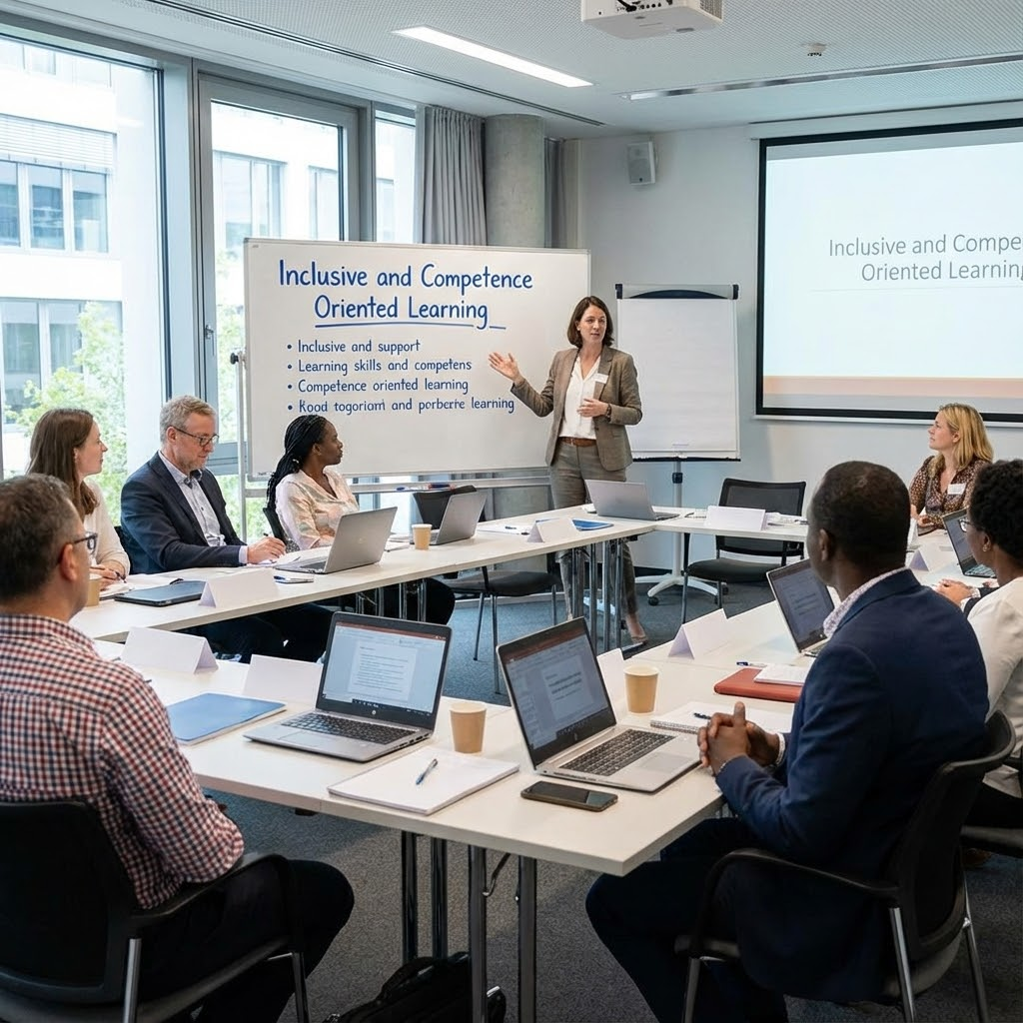
Conclusion
As educators, our role is not simply to transfer knowledge, but to remove barriers, facilitate growth, and encourage learners to make informed, autonomous use of technology. By fostering competence, confidence, and self-direction, we contribute to a culture of lifelong learning where adults are equipped to navigate change and participate fully in the digital world.

Slide 20

References
European Commission. (2022). European Digital Competence Framework for Citizens (DigComp 2.2): With new examples of knowledge, skills and attitudes. Publications Office of the European Union.
Redecker, C., & Punie, Y. (2017). European Framework for the Digital Competence of Educators (DigCompEdu). Publications Office of the European Union.
UNESCO. (2021). Reimagining our futures together: A new social contract for education. UNESCO.
UNESCO. (2018). A global framework of reference on digital literacy skills for indicator 4.4.2. UNESCO.
OECD. (2021). 21st-century readers: Developing literacy skills in a digital world. OECD Publishing.
Belshaw, D. (2014). The essential elements of digital literacies. self-published.
Freire, P. (1970). Pedagogy of the oppressed. Continuum. (Foundational for learner agency).
JISC. (2019). Digital experiences insights survey: Exploring learners’ digital experiences. JISC.
Mezirow, J. (1991). Transformative dimensions of adult learning. Jossey-Bass.
Brookfield, S. (2015). The skillful teacher: On technique, trust, and responsiveness in the classroom (3rd ed.). Jossey-Bass.

Slide 21

Congratulations on completing the Unit “Inclusive and Competence Learning”!

Slide 22






Project partners:
Project n° 2024-1-AT01-KA220-ADU-000254167
„Funded by the European Union. Views and opinions expressed are however those of the author(s) only and do not necessarily reflect those of the European Union or OeAD-GmbH. Neither the European Union nor the granting authority can be held responsible for them.“

